Slide 1
Handy Info I Wish Someone Had Told Me Back In 2017
Hamish Bultitude
14th Feb 2020

Slide 2
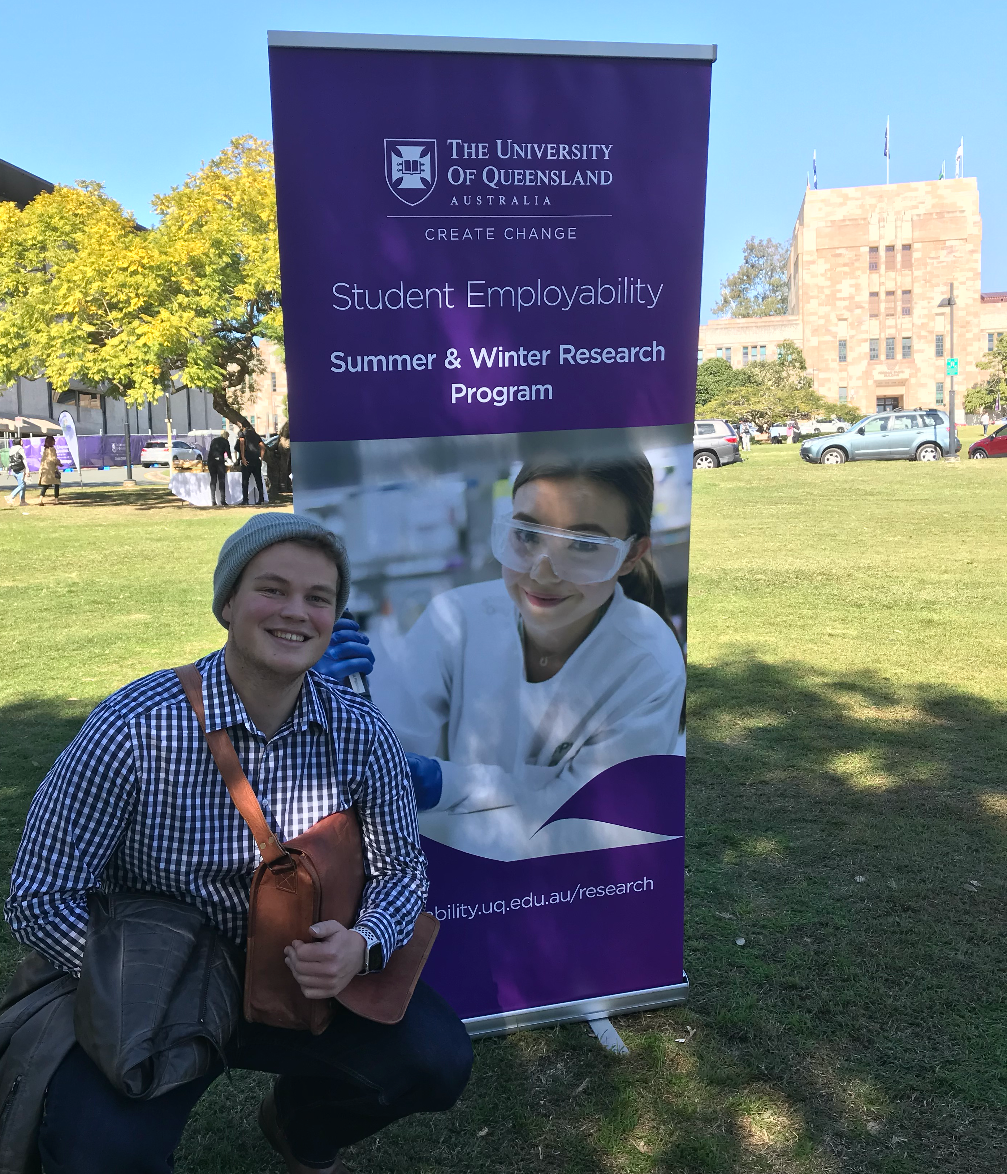
About Me…
Hamish Bultitude
Third Year Biomed & Comp Sci at UQ
Mr Herring Graduate from 2017
Winter Research - QIMR
Research Scholar - QIMR
Tutor CSSE1001 @ UQ
Cambridge Summer Science 2020

Slide 3
About Me…
Loves…
C, Java, Python, Swift (iOS)
Prosthetic’s Development

Slide 4
About Me…
Loves…
C, Java, Python, Swift (iOS)
Prosthetic’s Development
Hates…
C, Java
Covered…
Chemistry, Python, Discrete Maths, HS Bio, Cells, Stats, Databases, Tissues, Java, Assembly & Logic, Genetics, Physiology, Also & Data Structures, C Prog, Graphics, Bioinf, Anatomy, Networks

Slide 5
Before we begin…

Slide 6
Now, tell me a bit about yourselves?

Slide 7
Grade 12
Assignments
Start early!
Get to know the syntax of the programming language
Write good documentation so Mr Herring can mark you well
Both comments in your code and supporting documents
LOOK AT STACK OVERFLOW
The entirety of my SQL & Database code was “inspired” by this godly website
…. and by extension much of my university work 😉
Test, Test, Test, Test, Test … TEST!

Slide 8
Grade 12
Generally
Start looking at python (if you haven’t already)
And for those serious, Java.
And for those REALLY SERIOUS, C programming ^{[1]}
Think about what other subjects you like at school, and think about doing a dual degree!
Learn GIT source control (https://learngitbranching.js.org)
Namely commit, push, and pull.
Learn UNIX commands ( cd , ls , vim , etc)
HAVE A ROUGH PLAN FOR BOTH FIRST AND SECOND YEAR
How many times have I seen people redo courses / replan their degree…
[1] Brian Kernighan’s Book - ‘The C Programming Language’

Slide 9
Degree Naming Breakdown
Bachelor of Biomedical Science and Science maj. Computer Science

Slide 10
Degree Naming Breakdown
Bachelor of Biomedical Science and Science maj. Computer Science
So, I am completing a dual degree, where in my science degree I focus on Computer Science
(I do different subjects from normal computer science students)

Slide 11
Dual Degree Options (UQ)
Business Management / Science
Laws / Science
Commerce / Science
Mathematics / Science
Engineering / Science
Journalism / Science
Economics / Science
Information Tech / Science
Arts / Science
Music / Science
Secondary Education / Science
Computer Science / Science
link to science course list
Biomedical / Science
link to comp sci single maj course list
science majors

Slide 12
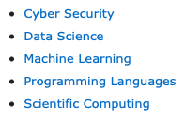
Major Options (UQ)

Slide 13
Courses
First Year | Python (CSSE1001) Databases & SQL (INFS1200) Discrete Maths (MATH1061) Maths C or Extended Maths C - Java (CSSE2002) Assembly & Computer Arch (CSSE2010) Elective Elective
Second Year | Computing Theory (COMP2048) C & UNIX (CSSE2310) Stats (STAT2203) Algorithms and Data Structures (COMP3506) - Elective Elective Elective Elective

Slide 14
Assignment Types
CSSE1001
Cleaning an Excel Spreadsheet
Analysing an Excel Spreadsheet
Creating a Tower Defence Game
CSSE2002
Creating a Basic Java Class System
Intermediate Class System
Applying previous work to simulate a bus network
CSSE2310
Creating a Card Game with well defined play
“Quicksand’ & “BOMB”
Creating another Card Game with Simulated Players
Networked depot simulation

Slide 15
Exam Types
Range from 2 hours (CSSE1001, 2002 etc) to 3 hours (CSSE2310)
About 23 pages in length (on average)
Start with simple questions, IE short coding problems (1 liners), move to conceptual problems and ALWAYS end with one (1st year) to multiple (2nd to 3rd year) programs that you have to write by hand
Midsemester exams exist that will be like the final but in a smaller form!
Often are supported by either open book style exam (can take in whatever you want) or a single page of double sided notes
Can act as a supplement for missed assignments
PAST EXAMS ARE SUPPLIED!!!

Slide 16
Assignment Samples
Exam Samples

Slide 17
Transitioning to University
Differences:
Exams often are 50% of your overall grade or higher
Assignments (comp sci) are marked by special programs, and often have less freedom than school ones
Plagiarism is checked CONSTANTLY and WILL result in BIG problems if you are found
Much less time is spent at uni, especially if at QUT
Often can strive for 1 day off (i opt for Friday <3)
No one is stopping you from NOT going to uni, less hand holding
Lunch times etc are not consistent, you have to organize your life socially and link up times with others.
Internships are offered regularly every winter and summer!! Just look out for them
Different styles of classes - practicals, tutorials, lectures
Lectures can have up to 500 people in them…. Or 12 if its Monday @ 8am lol
No one is reminding you to hand in assignments or pushing you along, if you miss a deadline, you lose 10% of max grade every day (varies between courses, comp sci = no grade for that assignment)
Often lectures can be watched online, thus you don’t have to go to class that day?
There is the possibility that your classes will clash, so some classes you will have to watch later

Slide 18
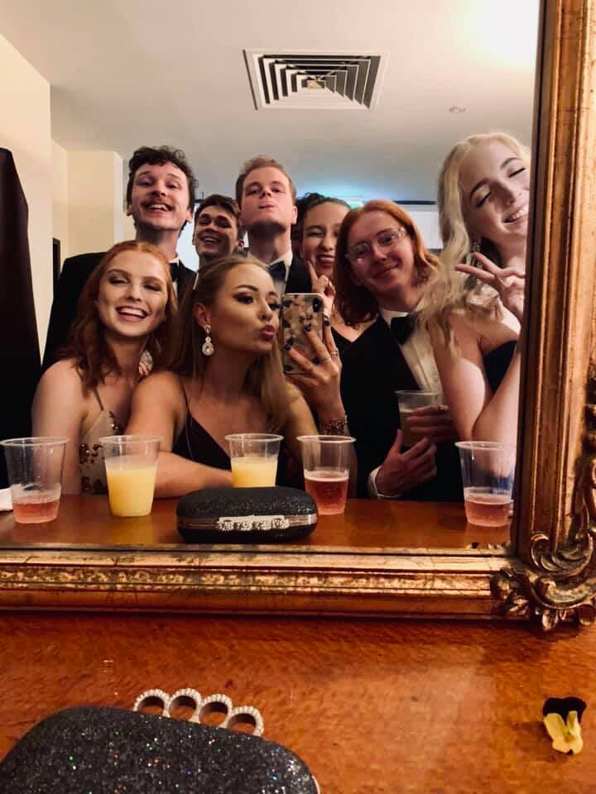
Don’t Stress though

Slide 19
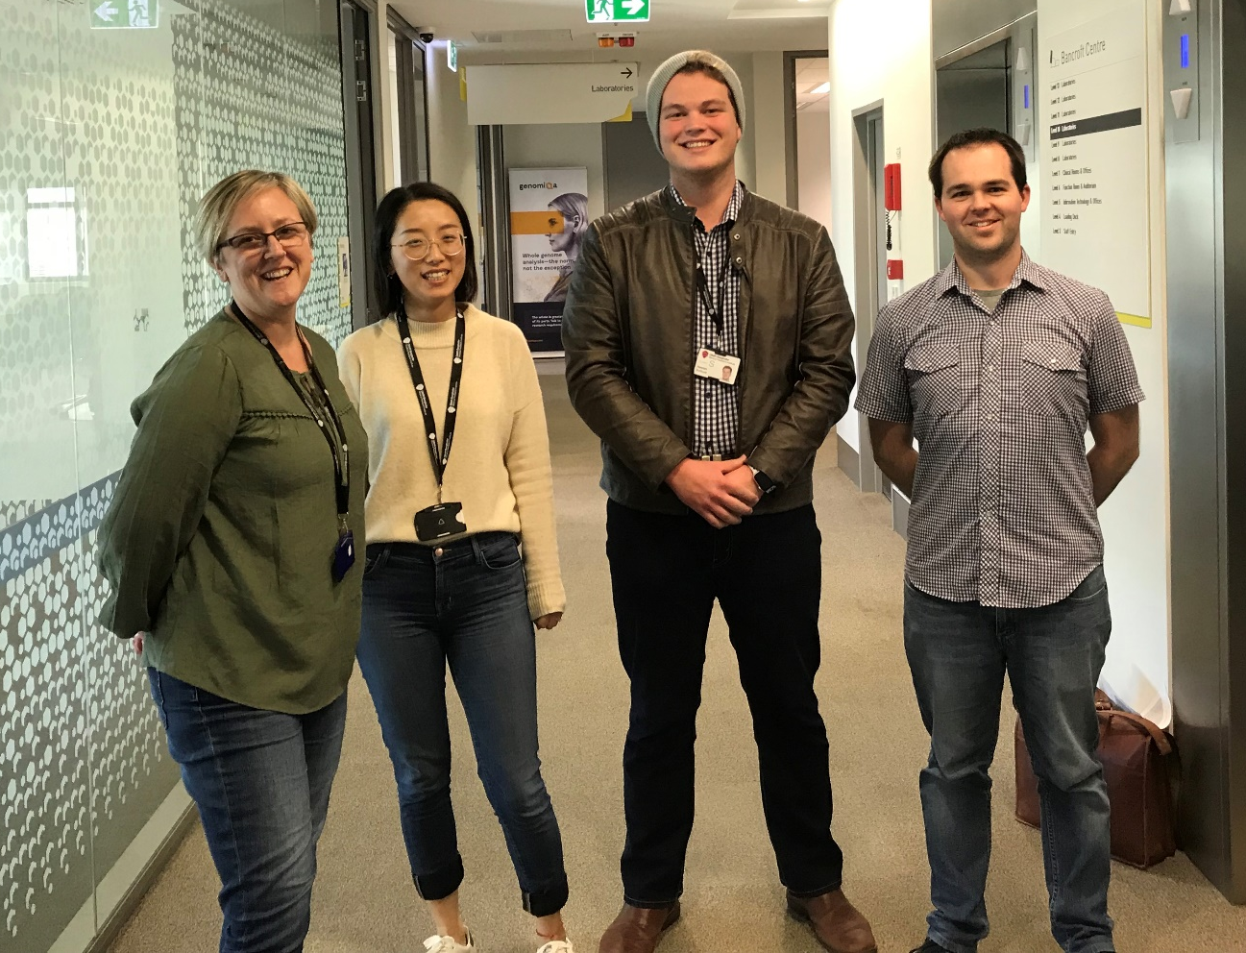
Opportunities
Winter & Summer Research Programs
involves studying with Researchers over a 4 to 12 week program to achieve real life solutions to problems!
I worked with Ann-Marie Patch at Queensland Medical Research Institute Berghofer in Herston on two projects, one as an intern, and another as an employee!
Research into Colorectal Cancer & Development of MultiQC RNASe-QC Analysis Module
Bioinformatics analysis of structural variant breakpoints in fragile sites across different cancer types
https://employability.uq.edu.au/summer-winter-research

Slide 20
Opportunities
UQ Volunteering
Opportunities to help out at UQ and abroad
Expand networks and get good accolades for your CV!
UQ Abroad
Study overseas for a short period or whole semester!
I am going to Cambridge over our winter soon on their science program
Opportunities range from Los Angeles, San Fran (both great for tech) and lots in Europe as well!
Tonnes of entrepreneurial programs as well to develop leadership, especially for women in STEM
UQ Clubs – Beach Volleyball, Computer Science, Harry Potter, Social Change, Computer Science! Anything you can imagine…
https://employability.uq.edu.au/summer-winter-research

Slide 21
Future Career Goals
Personally, I have found that Bioinformatics is very interesting, but I love the idea of prosthetics and the interfaces between computer science and the brain / nervous system
In contact with researchers from around the world who’s papers I have read, and am currently organising projects / opportunities with them for further study (potentially meeting one on the way to my Cambridge exchange)
https://gfycat.com/immensefrailbandicoot

Slide 22
Wrapping up…
Name assignment advice for Year 12
Name general advice for Year 12
What book did I recommend to read for C Programming?
How long do uni exams often go for?
What are some positives about uni exams?
What are some dual degree options to pair with computer science?
What are some major options for computer science?
Name an opportunity that UQ supplies?

Slide 23
Questions?

